Slide 3
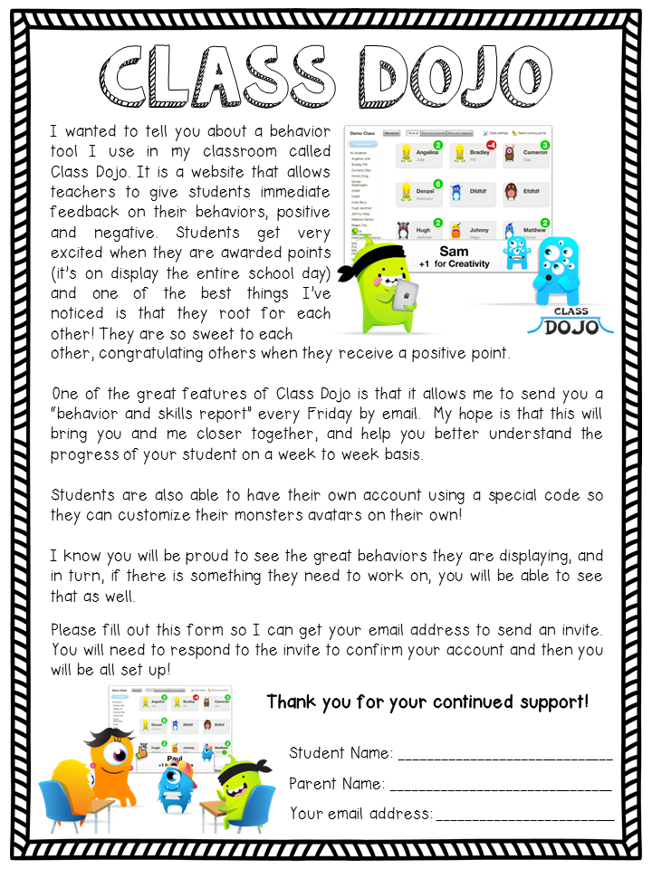

Slide 4
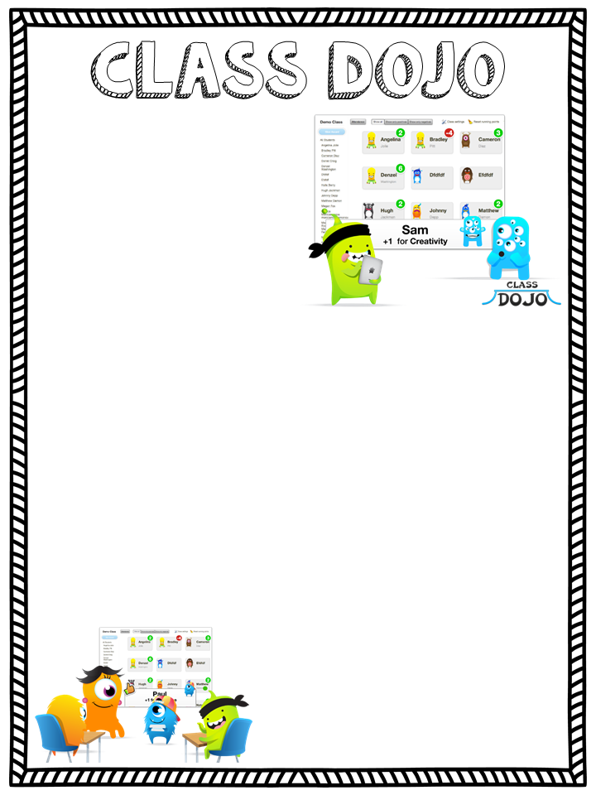
I wanted to tell you about a behavior tool I use in my classroom called Class Dojo. It is a website that allows teachers to give students immediate feedback on their behaviors, positive and negative. Students get very excited when they are awarded points (it’s on display the entire school day) and one of the best things I’ve noticed is that they root for each other! They are so sweet to each
other, congratulating others when they receive a positive point.
One of the great features of Class Dojo is that it allows me to send you a “behavior and skills report” every Friday by email. My hope is that this will bring you and me closer together, and help you better understand the progress of your student on a week to week basis.
Students are also able to have their own account using a special code so they can customize their monsters avatars on their own!
I know you will be proud to see the great behaviors they are displaying, and in turn, if there is something they need to work on, you will be able to see that as well.
Please fill out this form so I can get your email address to send an invite. You will need to respond to the invite to confirm your account and then you will be all set up!
Thank you for your continued support!
Student Name: ______________________________
Parent Name: _______________________________
Your email address: _________________________

